Slide 1
Kickstarter Oracle
Kickstarting your Kickstarter campaign

Slide 2
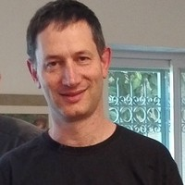
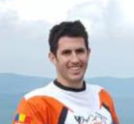
Team regression
Elad Toister
Yotam Nahum

Slide 3
Content
Market reminder | Meet Kickstarter Oracle | Data Methodology | Prediction models | Insight | Implication

Slide 4

68%
$4.6B
Overall funding in years 2009-2018
a global crowdfunding platform where “creators” can run “campaigns” for people to fund and “back” their project
Unsuccessful campaigns in years 2009-2018

Slide 5
Market reminder #1
The most popular segments are not necessarily
the most successful in fund raising.

Slide 6
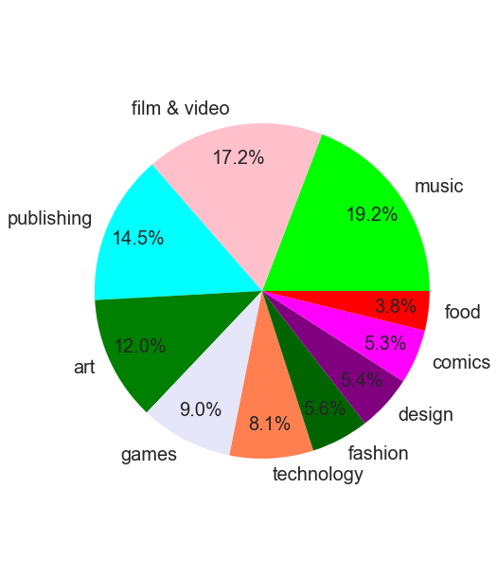
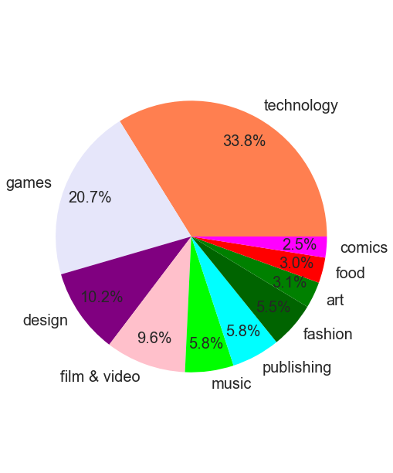
Campaign Segmentation
Money Raised

Slide 7
Market Reminder #2
High Goal=Bad Odds

Slide 8
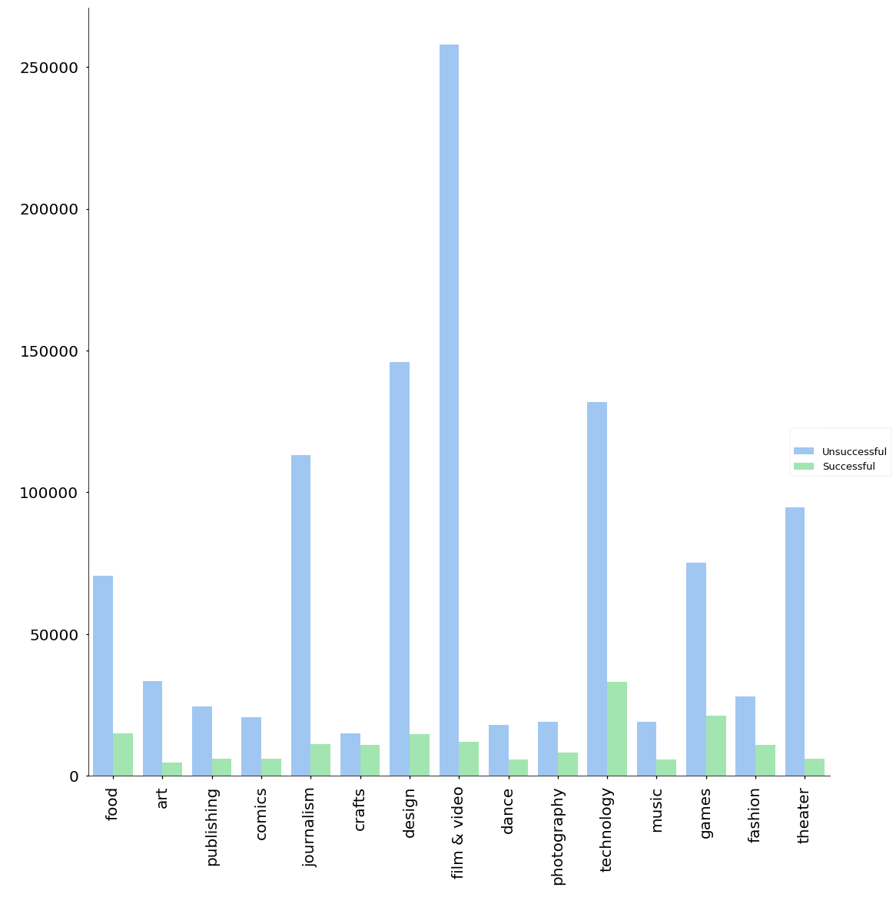
Campaign goal
Goal
Category

Slide 9
Market reminder #3
Once you reach your goal- the funds increase

Slide 10
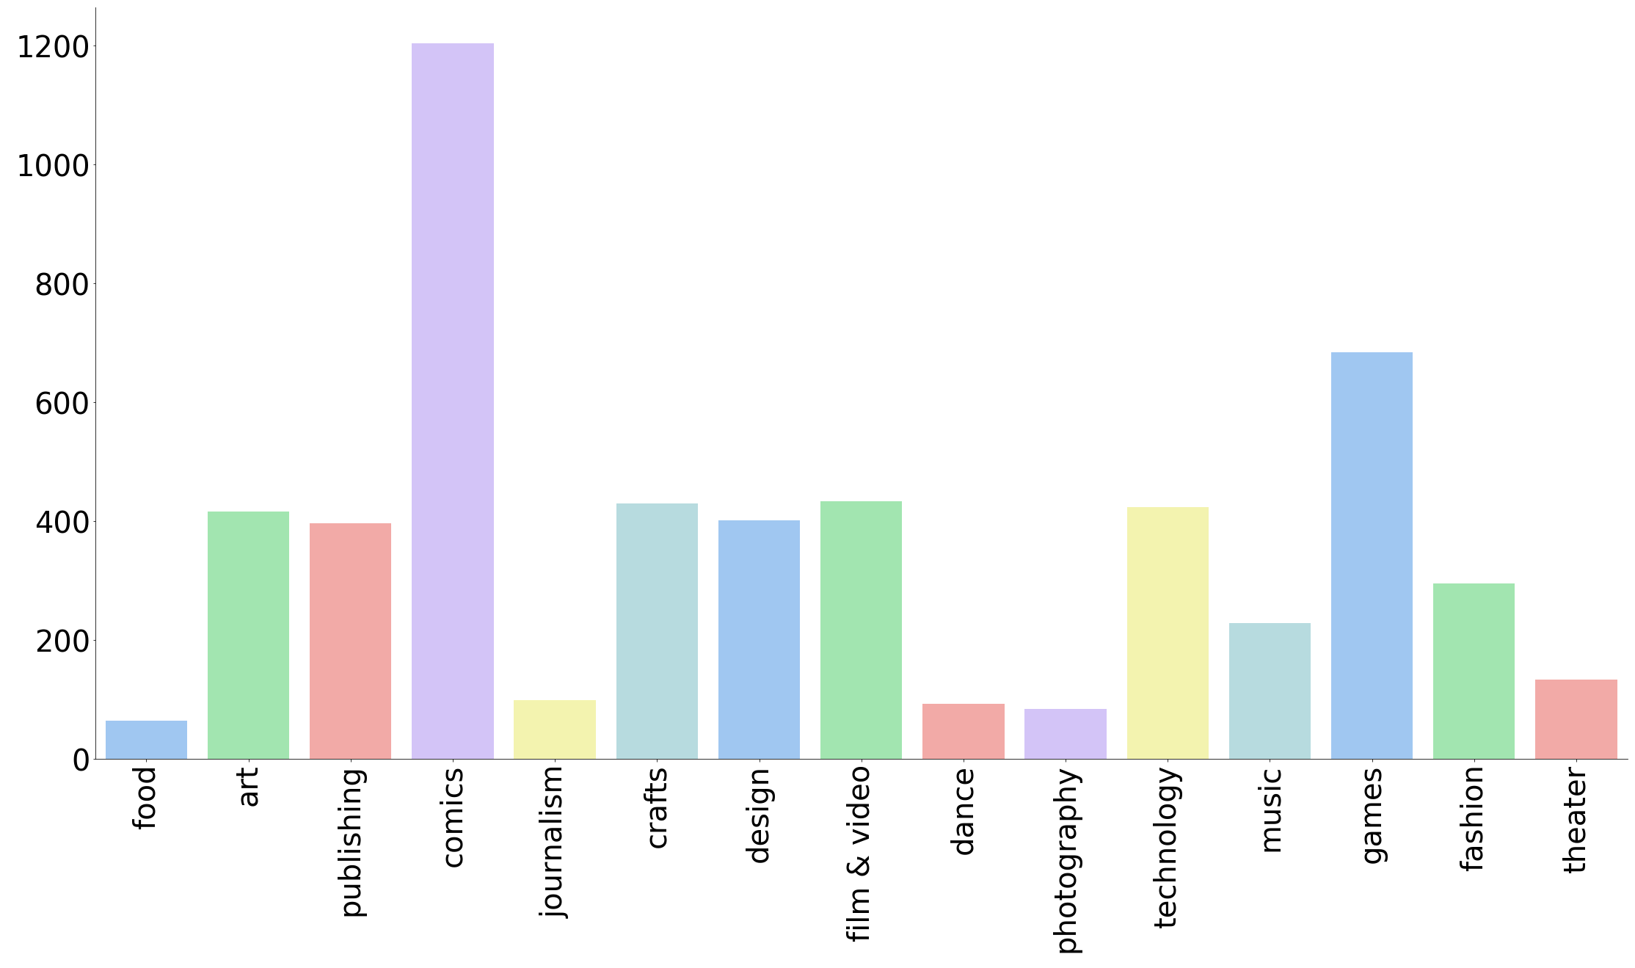
Successful campaigns pledged percent
pledged percent
Category

Slide 11
Meet Kickstarter Oracle

Slide 12
Our Goals
Understand the marketplace.
Provide insight into what attributes would make a successful campaign.
Tailor the funding goal per campaign specifics.

Slide 13
Data Methodology

Slide 14
Kickstarter Campaigns
200K+
Existing Data:
Campaign name and blurb (description)
Funding goal, number of backers and amount pledged
State: successful, failed, cancelled, or live
Time of creation, launch and deadline
Country and currency
Category
Extracted Data:
Day of week and hour of day for creation, launch and deadline
Time delta
Pledged percent
Text info
Number of existing or recent campaigns in the category
Mean&Median goal, pledged and pledged percent

Slide 15

Some new Insights from our data

Slide 16
Text analysis

Slide 17
Text parameters (mean)
Success
Failed
Name length
Name is a question?
Name is an exclamation?
Name letters are upper?
How many symbols in the name?
How many words are in the name?
The name vowel to word ratio
How many words are in the product description?
The product description vowel to word ratio
How many symbols in the product description?
36.6
0.003
0.08
0.033
6.7
6.1
0.3
19
19
23
32
0.003
0.08
0.039
5.5
5.29
0.32
19
19
23

Slide 18
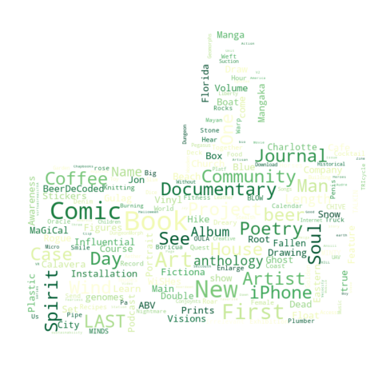
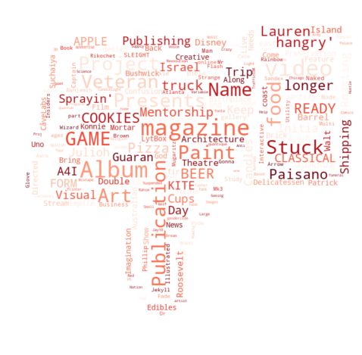
Campaign “BuzzWords’’

Slide 19
Prediction models
Categorical prediction | Regression prediction

Slide 20
Success prediction
Decision Tree Classifier | Random forest | GBM

Slide 21
Key parameters
Goal
Goal ratio (Goal\Last year mean Goal)
Period mean\median Goal
Period mean\median pledged percent
Period mean\median total pledged
text parameters
US
Campaign categories
Launched-created length
Goal \\ 1000
Market saturation

Slide 22
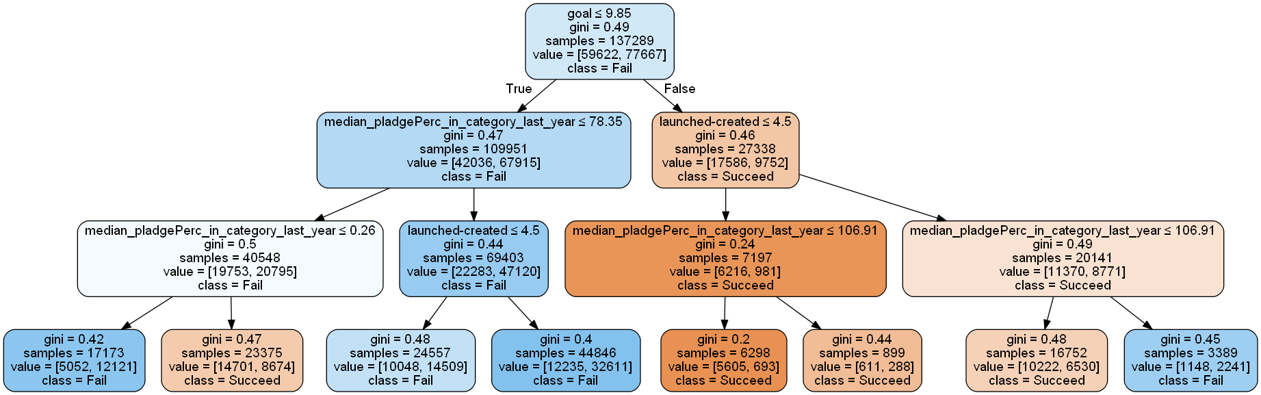
Decision Tree Classifier

Slide 23
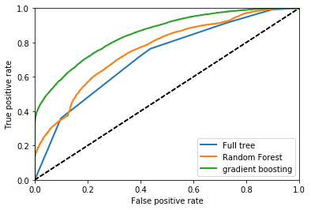
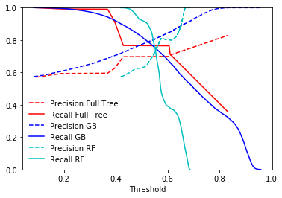
ROC | Precision
Decision Tree Classifier
Precision: 0.85
Recall:0.75
Random forest (RF) Precision:0.83
Recall:0.6
GBM
Precision:0.9
Recall:0.6

Slide 24
Pledged prediction
Polynomial Regression

Slide 25
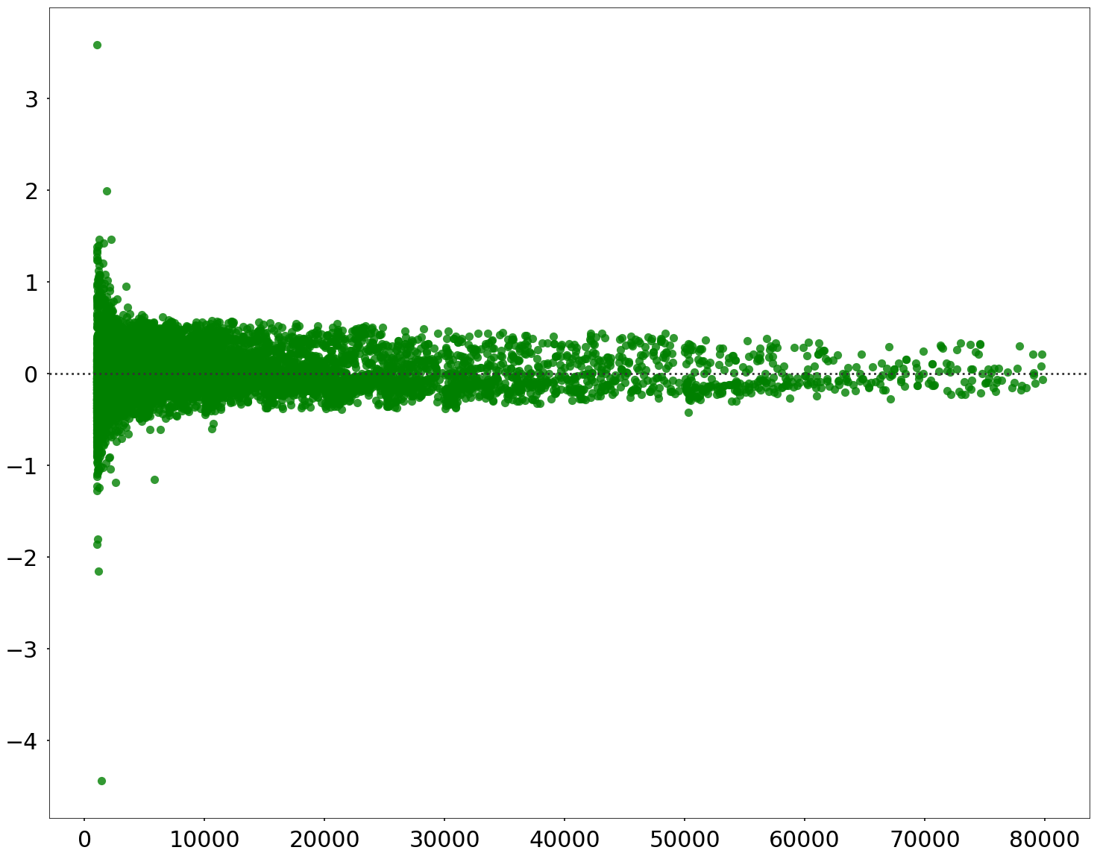
Polynomial Regression
Pledge prediction
Conservative prediction
Pledged percent 100%-250%
R² = 0.93
Risky prediction
Pledged percent 100%-600%
R² = 0.83
Residual% = (Y-predicted - Y-test) / Y-Test
USD Pledged

Slide 26
Insights for success

Slide 27
Insights
Success prediction and pledged prediction- two separate steps:
The first step is to set the pledge goal (informal – known only to the entrepreneurs) to the real amount of money the campaign need (using polynomial regression)
The second step is to find the formal goal (to be published in kickstarter) that will be low enough to increase funding success chances and high enough to reach the actual pledge goal (using categorical prediction)
The market state info has more influence then the campaign ‘’dry’’ attributes
The higher the pledge percent, the lower the predict precision

Slide 28
Next time
The product

Slide 29
The product
A User interface
Fill out the campaign description and the real pledge goal
we aim to campaigns between 1,000$ to 100,000$
Get betterment recommendations for your attributes
get your Kickstarter campaign goal!

Slide 30
Thank You

